Slide 1

Economic Struggles
A relationship between GDP
and unemployment
Datathon 2026
Team Name: NaNaNaNa
Members: Sabrina Moore, Kayla Perkins, Christopher Hurtado
Page 01

Slide 2
Team NaNaNaNa
Is there a disparity between how GDP affects men and women’s unemployment rate?
Page 02

Slide 3
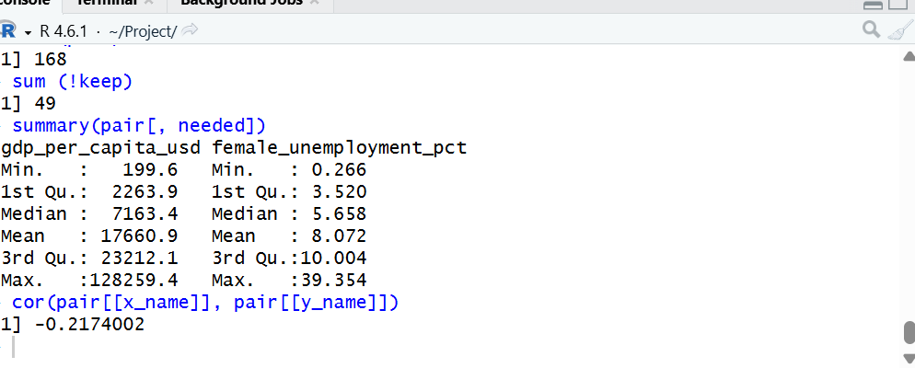
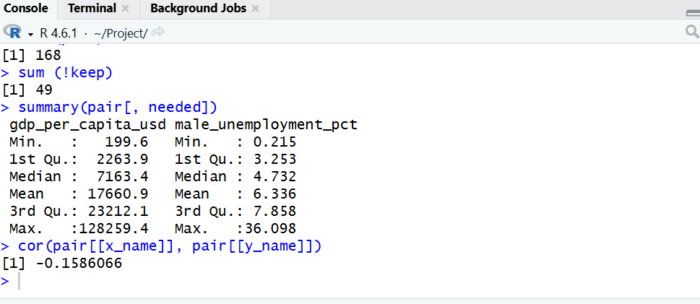
Analysis
Team NaNaNaNa
Variables
Gdp_per_capita_usd
female_unemployment_pct
male_unemployment_pct
Why compare men and women’s unemployment rate?
Men and women tend to cluster in different sectors (domains of work)
Factors like gender, race, and disability can show systemic disadvantages
Page 03

Slide 4
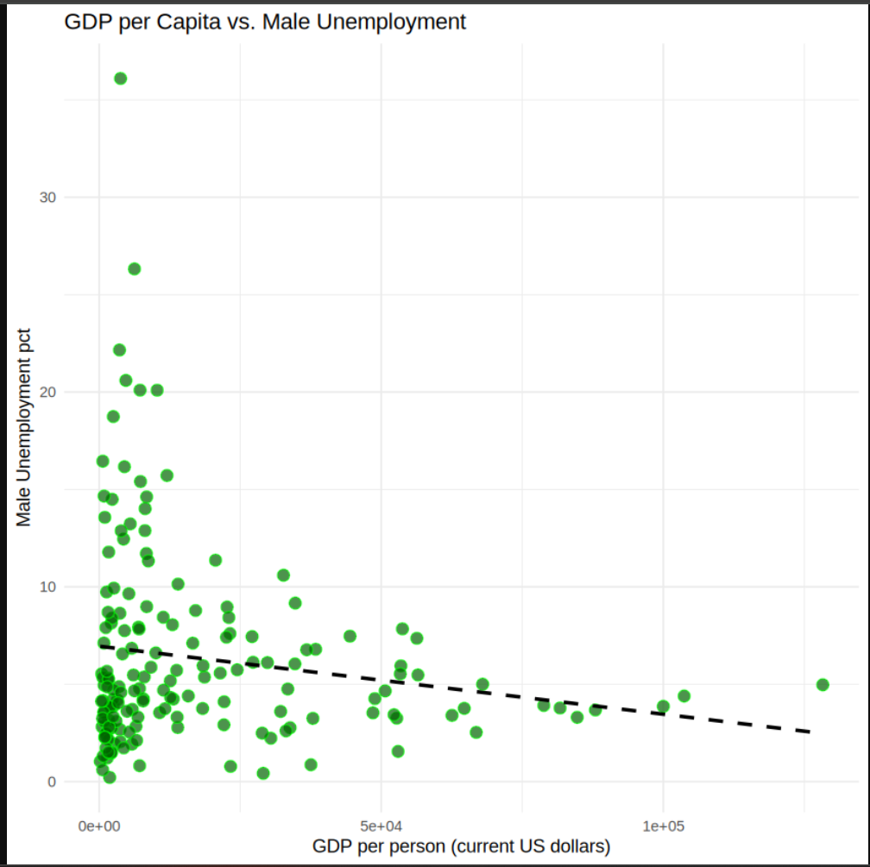
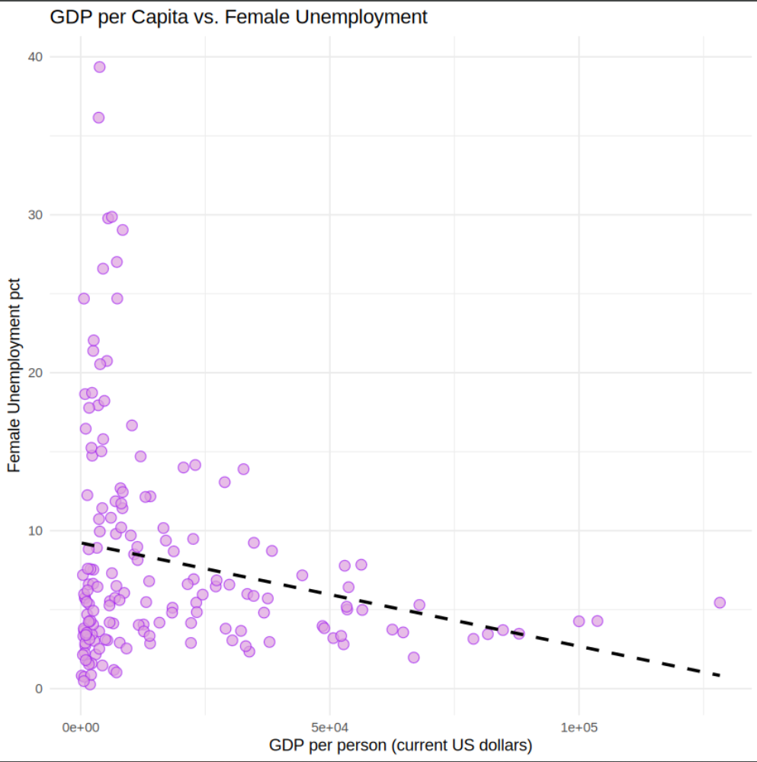
Analysis
Team NaNaNaNa
Page 04

Slide 5
Data Insights/Conclusion
Team NaNaNaNa
Gender
Overall
Further Thoughts
The difference between male and female unemployment is small and does not support the idea that a country’s GDP alone affects women and men differently.
What other factors, like work domains/career fields could contribute to the small gender gap?
How does this trend change over time?
Female Unemployment is slightly higher, but mainly affected by outliers
When GDP is lower, both men and women unemployment percentage is high. Alternatively when GDP is higher, both men and women unemployment percentage is low.
Some low-GDP countries have near 0% unemployment, while others spike very high (some near or above 20-30%).
Mean for female unemployment: 8.072
Mean for male unemployment: 6.34
Unemployment is right skewed which suggests unusually high unemployment rates.
Page 05

